Slide 1
Access User Interface

Slide 2
Access User Control Methods
Custom Navigation Panes
  Allow custom navigation panes
  Custom groups hold database objects
  Categories of objects can be hidden
Switchboard
  This is a special menu form that is designed to be displayed on database open
  Items on the form execute macros to work with objects
  Switchboard Manager provides easy construction for common items like forms and reports

Slide 3
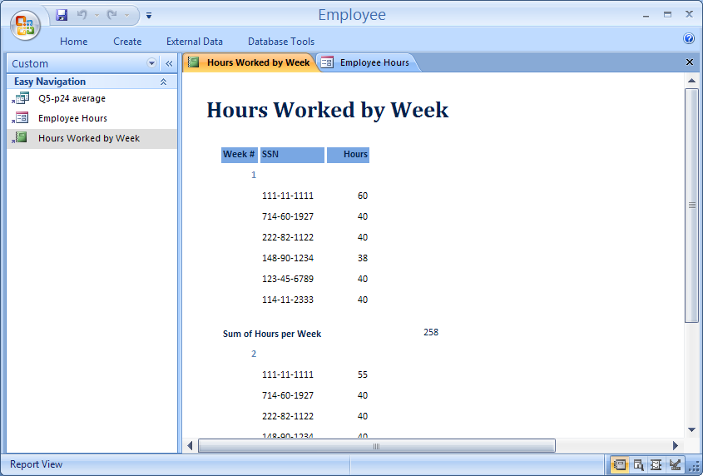
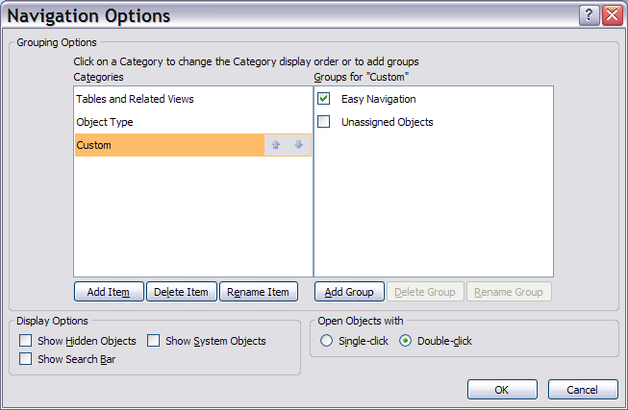
Custom Navigation Pane
See Tutorial B
for details

Slide 4
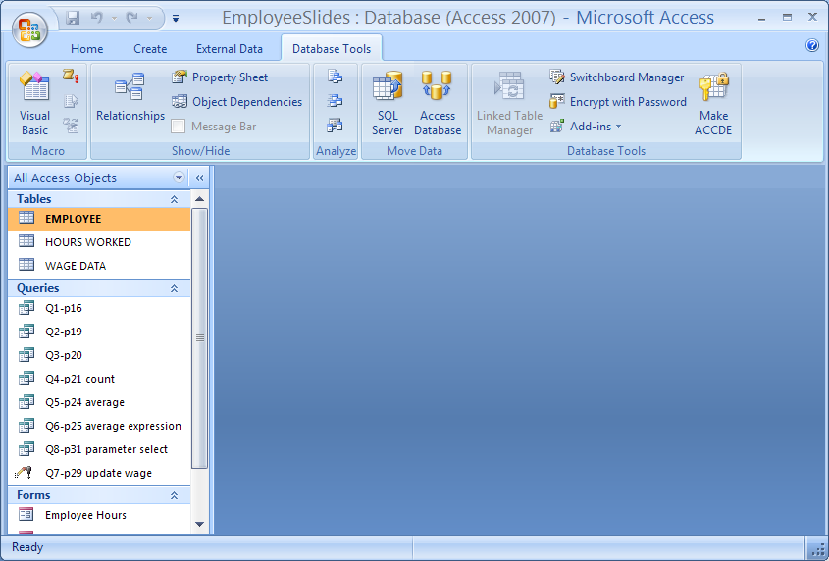
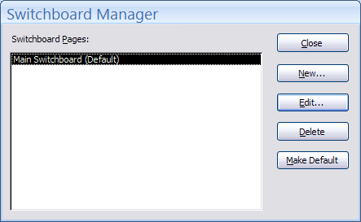
Use Switchboard Manager to Create and Edit

Slide 5
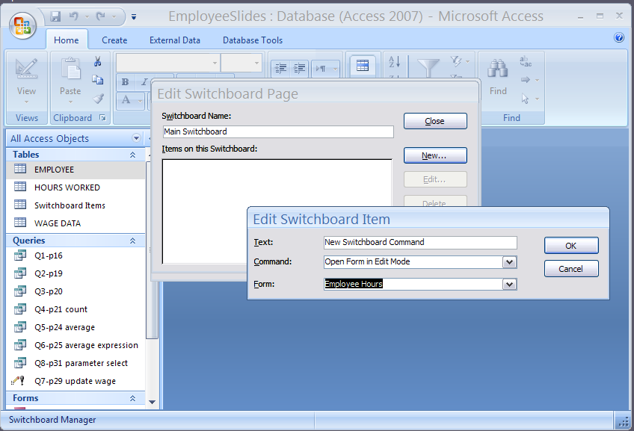
Adding Form Item to Switchboard

Slide 6
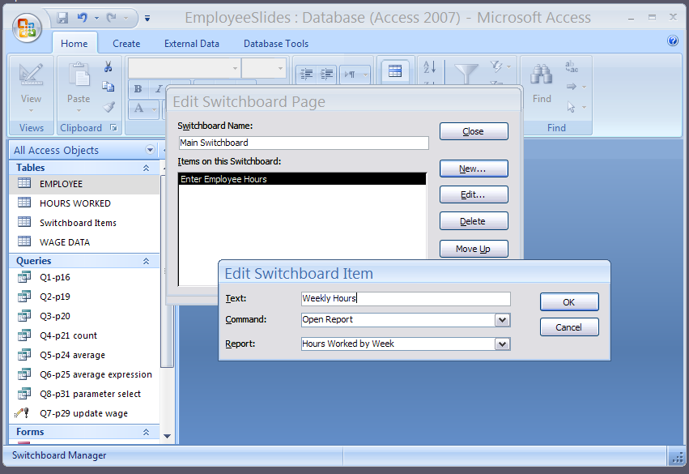
Adding Report Item to Switchboard

Slide 7
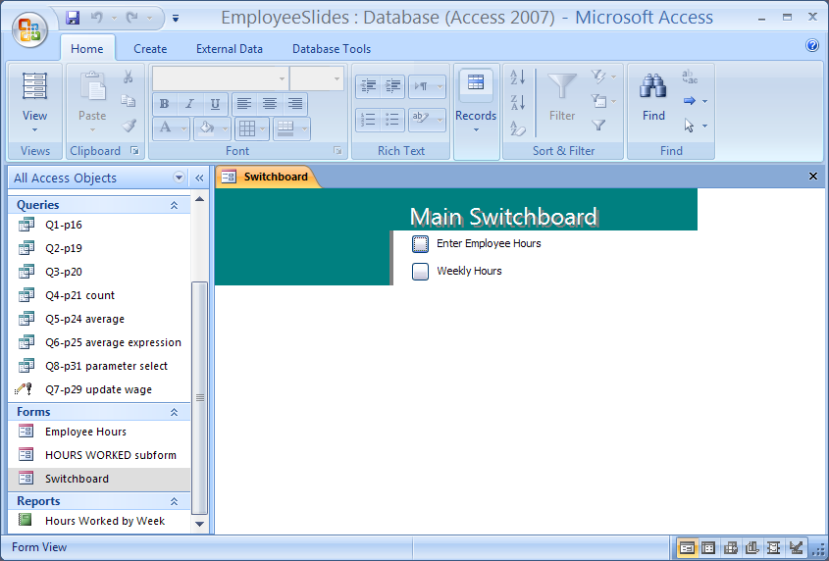
Resulting Switchboard Form

Slide 8
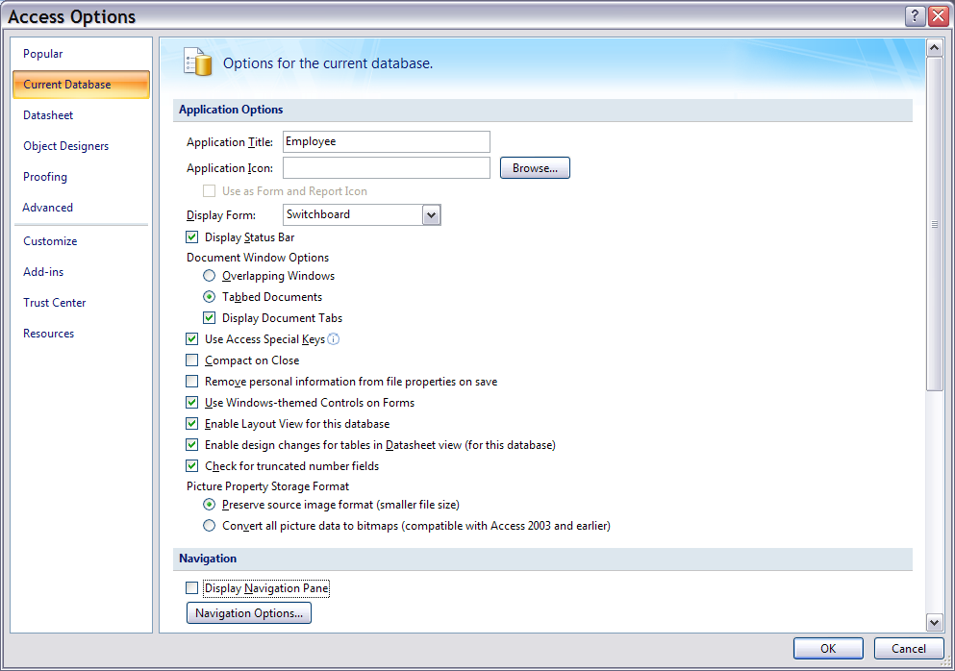
Set Access Options to use Switchboard
Select Switchboard
Uncheck Pane

Slide 9
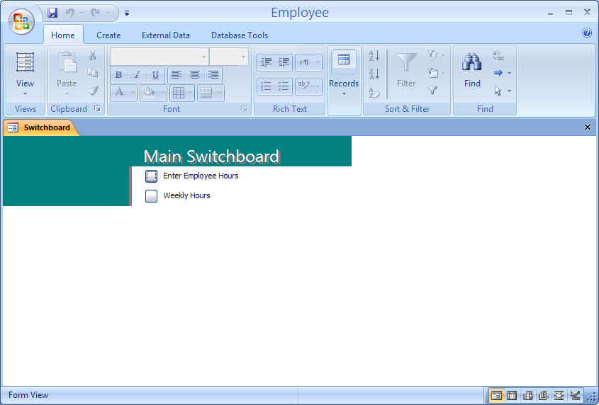
Database opens showing only switchboard

Slide 10
END

